Slide 1

Descriptive Statistic
Zain

Slide 2
Product sales Analysis
We have a dataset of product sales .In which we have the different columns and rows,the columns containing the variable and different rows are containing the observation.on the basis of the given dataset we are going to perform analysis and present the new insights from the given data set of product sales

Slide 3
Aim
To analyze Data
To find anomalies
To preprocess data
To cleanse the data
To provide the insights on data with different visualization

Slide 4
Case
To provide detailed insight on IPL in various dimensions like
Date/month/year
Product wise
Product category wise
Temperature wise

Slide 5
Audience
Store Managers
Business Owners
Product companies

Slide 6
Nature of Data
We have data in Vaccination details
Product wise
Sales value detailed data
Around 100 records ,around 3 categories & around numerical variables such as sales are contentious

Slide 7
Visual Insights – Sales Product wise
S1 Lottery is top product of 2011

Slide 8
Visual Insights – Sales Product wise
S1 Lottery is top product of 2012

Slide 9
Visual Insights – Sales Product wise
S1 Lottery is top product of 2013

Slide 10
Visual Insights – Sales Product Category wise
Food is top product category of 2011

Slide 11
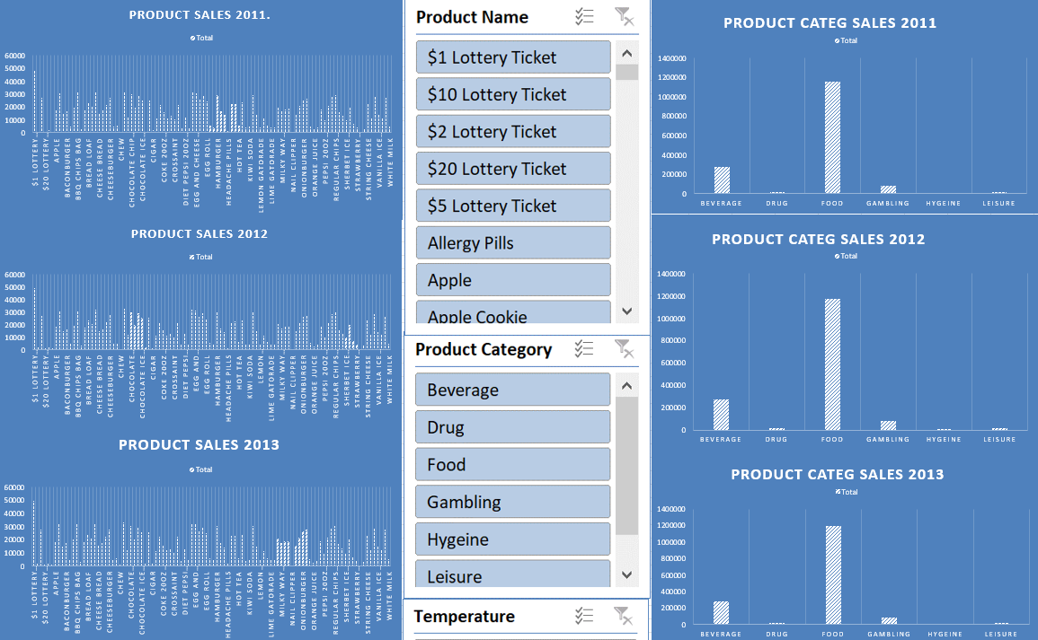
Visual Insights - Overall

